Slide 1

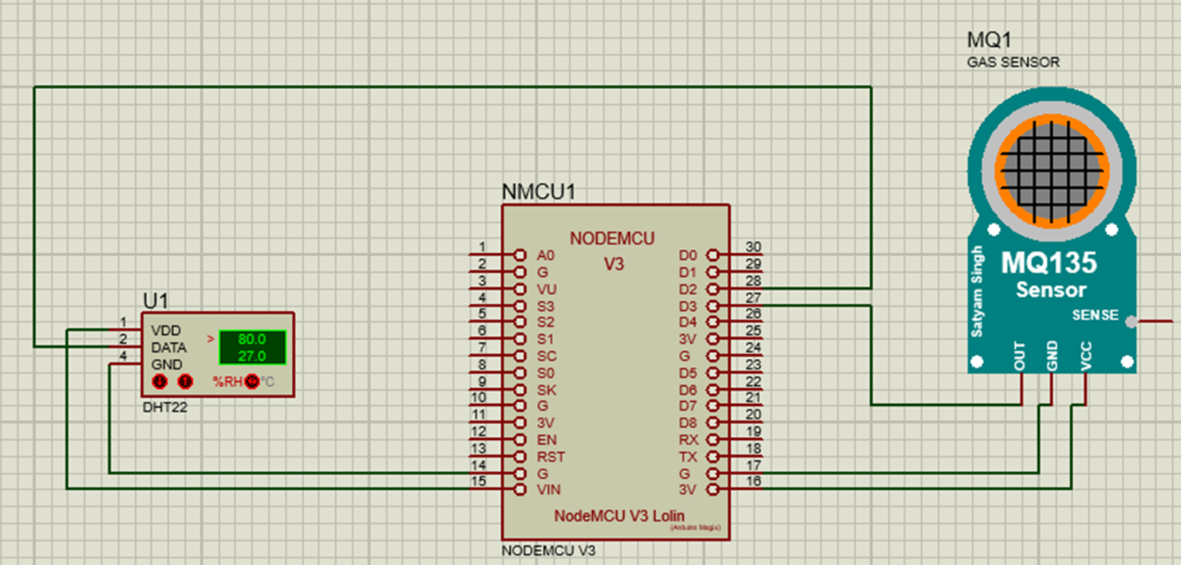
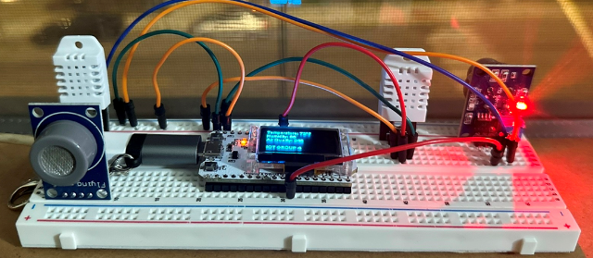
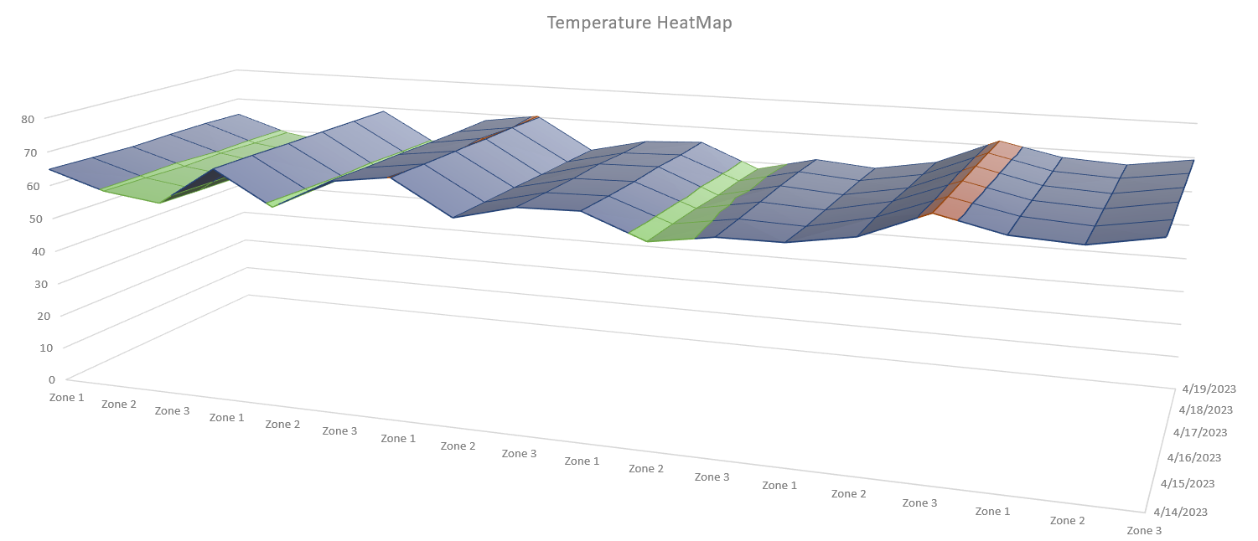


Temperature, Humidity and Air Quality Monitoring using ESP32
Bhavyanth Kondapalli, Chandini Dommaraju, Prathyusha Kondabolu, Samrin Shaik,
Sai Krishna Prasad Kammili, Shirisha Baddam, Rakesh Rao Thakkalapelly, Amarnadh Peapalla
Advisor: Dr. Sejun Song, University of Missouri, Kansas City
Monitoring temperature, humidity, and air quality helps ensure a comfortable and healthy indoor environment. Poor air quality can lead to various health issues such as respiratory problems, allergies, and asthma. By monitoring temperature and humidity levels, you can optimize energy consumption by adjusting heating, ventilation, and air conditioning (HVAC) systems accordingly. Hence our goal is to build a system which monitors all these parameters and provides meaningful insights.
MOTIVATION
Hardware
Source Code
Circuit Diagram
ESP 32, DHT22, MQ 135, Jumper wires, Breadboard are the hardware components used to measure the temperature, humidity.
Source code is written to read data from 2 sensors and write it to google sheets as well as blynk dashboard
Zones
Data
Heat Maps
Data is recorded in google sheets with different zones by ESP 32, Temperature and Humidity sensors
Finally heat maps are generated to analyze the temperature and air quality in different zone.
Results
Conclusion
Heatmaps for temperature, humidity and air quality are generated for every 5 minutes timestamp for a week. We’ll be able to analyze the visualizations and make decisions based on the graphs produced for all the scenarios in the motivation (but not limited to).

